Slide 1
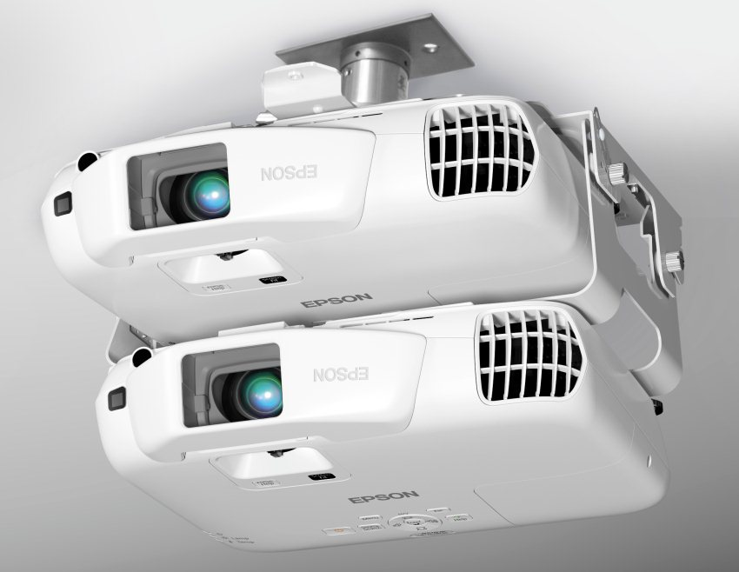
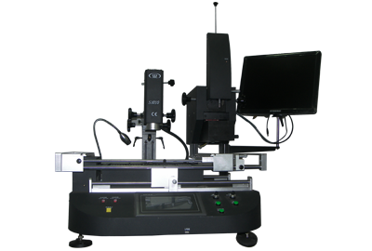

Slide 2
EXPERT INSTITUTE OF ADVANCE TECHNOLOGIES PVT . LTD
We are thankful to you for showing your interest in starting an institute in your city.
To assist you in the right direction we have collected all relevant information, to make it easy for you to choose right thing.
Being successful in an education venture depends on multiple factors. We insist that you do your own workings based on current realities and knowledge of your territory.
You can seek our assistance wherever required and we can work together to create a mutually beneficial and highly successful Business Venture. We are sure that this business will provide you with great income and experience.

Slide 3
EXPERT INSTITUTE OF ADVANCE TECHNOLOGIES PVT.LTD offering new age career oriented courses targeted at component repairing segment.
The EXPERT INSTITUTE has crossed many a milestone in its journey of technical education has been established since 2008 in Delhi. And has created his owned ranking in Asian’s region. EXPERT INSTITUTE has guided great strides in the field of technical education and provided employment & self-employment opportunities to more than 1000 Student’s Expert’s Instructors and consultants are best in their class having achieved several years of experience in the areas of Repairing network.
The technically oriented programs/courses offered by EXPERT INSTITUTE are designed to train the student to become well versed & accelerate in their respective fields & to meet the growing industry demand. Expert plans to expand its chain of learning centers to offers quality education to students in India.

Slide 4
Trained Manpower
The EXPERT has been witnessing phenomenal growth over the last few years. The boom in this sector has opened the doors to many opportunities. Today India’s technical Repairing network is the 2nd largest in the world with the potential to reach 80 Crores subscribers by 2017.
It is our estimate that more than 10 lakhs trained professional are required to fulfill the direct and indirect employment and self-employment opportunities created by and within this industry. While the demand is high the supply is low due to lack of good training infrastructure and practices.
In India, crores of students pass out only small percentage of this are destined to find seats in colleges and continue education. In addition there are crores of students who drop out of school after 8th grade. All these students require vocational training to develop specialization skills to become industry ready.
Today EXPERT Franchisees are in the best position to take advantage of this huge opportunity. EXPERT students are successfully self employed and are working like Nokia, Samsung, Sony, Hcl, Dell, IBM, Motorola etc.

Slide 5
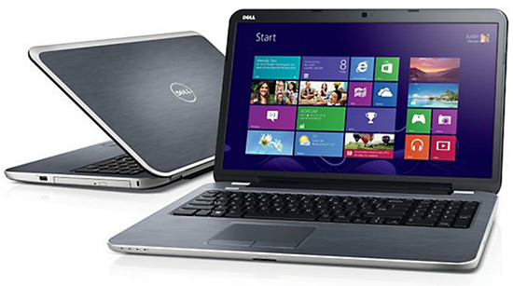
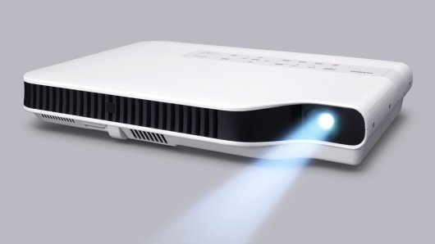
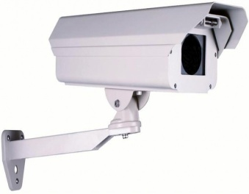
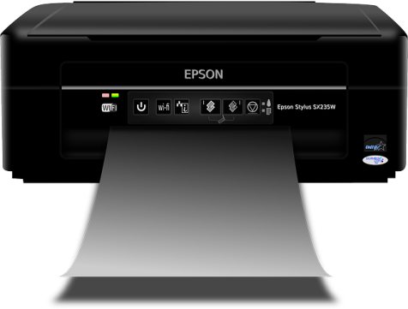
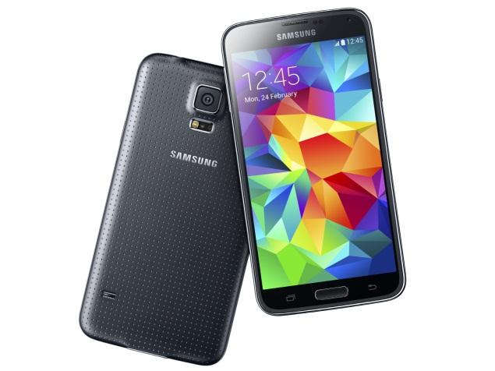
Courses offered
TRAINING
Laptop Repairing
Projector Repairing
Tablet PC Repairing
Printer Repairing
Data Recovery
CCTV Repairing
Mobile Repairing

Slide 6
Locating Your EXPERT Center
Since you will be running an Education centre where there would be considerable flow of students. It should be in a location which is convenient for them to attend.
Please keep in mind the following factors when you locate your centre:
Highly visible Frontage/signage.
High student flow area.
Premises approved for commercial use.
Adequate Electricity and water provision.
Toilet facility for staff and students
Long lease period.
Interior space, open with minimum pillars for best
utilization.

Slide 7
PRE LAUNCH SUPPORT
Advising on centre layout
Assistance in employee selection
and recruitment
Initial Training to all staff.
ON GOING SUPPORT
Guidance and support to achieve targets
Skill up gradation training for all staff
Centrally created advertising campaigns
Regional conferences
Information sharing
Placement assistance to local placement cell
Adding new courses
Tie-ups and collaboration with industry.
Centralized certification
Expert online training softwares.

Slide 8
EARNING
10 ADMISSIONS PER MONTH
10 x Rs.25000
Rs.2,50,000
SALARY EXPENSES
(Rs.30,000)
EXPENSES INCLUDING RENT
(Rs.20000)
Rs.50000
EXPENSES
TOTAL PROFIT
Rs.2,00,000

Slide 9
If you like what you have read so far …
Fill up the Franchise Business Projection form.
Plan a visit to our Head office.
Reserve your territory by paying non-refundable
initiation fees .
Get your location approved.
Launch EXPERT Centre in 10-15 days
We are actively recruiting new franchisees and look
forward to hearing from you soon.
Take a look on next page which contains franchise
packages.

Slide 10
Franchise packages
Rs.1 Lac
Rs.2 Lac
Update new Technologies
Service Center Support
Online Technical Support
ISO Marked Certificate.
Google Online Marketing.
Online Training Software for Students and management.
Update new Technologies
Allowed to open Expert Institute in three districts and its Google online marketing is also provided.
Service Center Support
Online Technical Support
Online Marketing.
10 Student Repairing Setup In LAB
Bios programmer
Diagnostic card
ISO Marked Certificate
Online Training Software for Students and management.

Slide 11
EXPERT INSTITUTE OF ADVANCE TECHNOLOGIES PVT LTD
2453, Hudson Line, Top Floor, Kingsway Camp, (Near G.T.B Nagar Metro Station Gate no 4) New Delhi - 110009
Contact No : 011-47814776, +91 9718888344, +91 9718888700 Email : admin@expertinstitute.in Skype : - Laptopexpert

Slide 12
